Slide 1
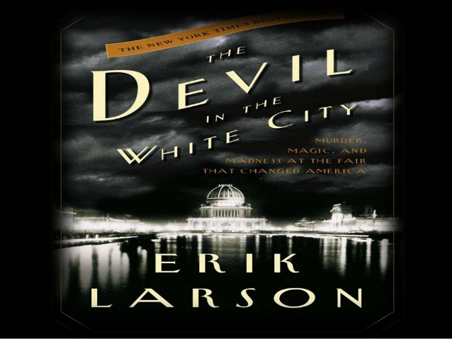

Slide 2
Erik Larson
Author (non-fiction)
Journalist
Historian
Contributing writer for Wall Street Journal, TIME Magazine, The New Yorker, The Atlantic, Harper’s

Slide 3
Author’s note
“In the following pages I tell the story of these men and this event, but I must insert here a notice: However strange or macabre some of the following incidents may seem, this is not a work of fiction” (Larson xi).

Slide 4
Author’s apology
“I beg forbearance, too, for the occasional side journey demanded by the story, including excursions into the medical acquisition of corpses and the correct use of Black Prince geraniums in an Olmstedian landscape”
(Larson xi).

Slide 5
World’s fair (world’s Columbian exposition) May-October 1893 Chicago, ILLINOIS

Slide 6
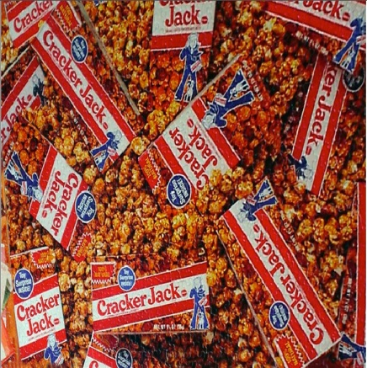
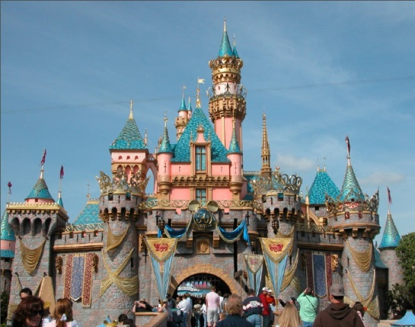
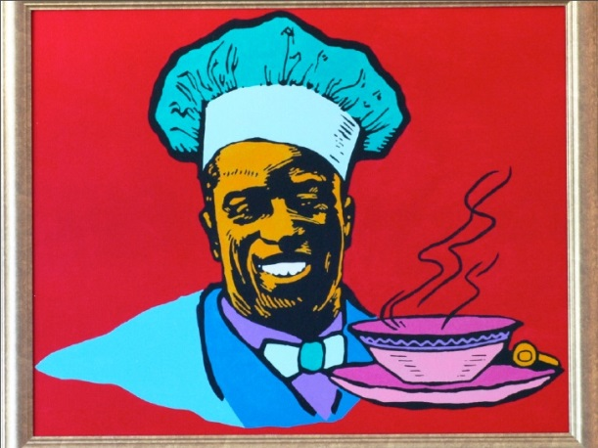
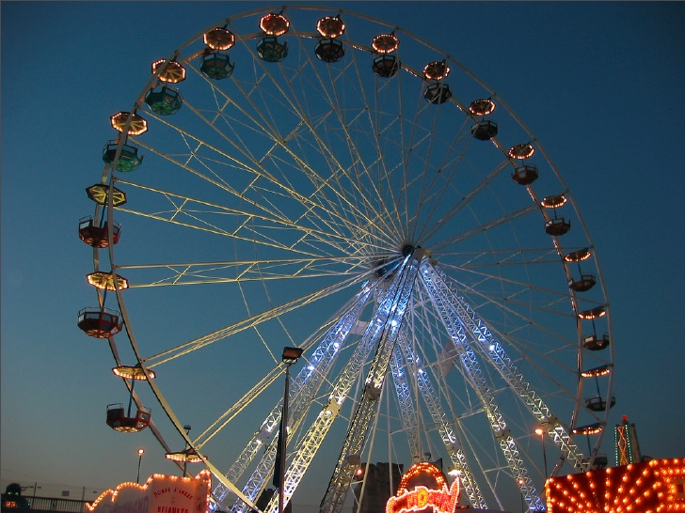
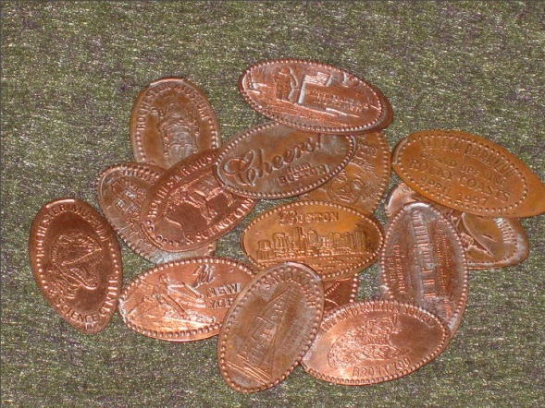
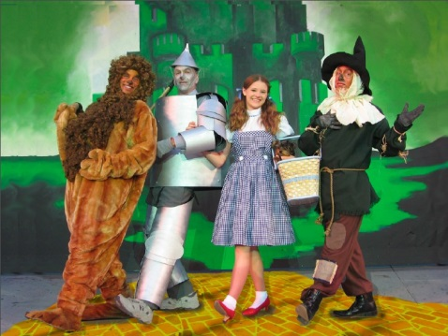
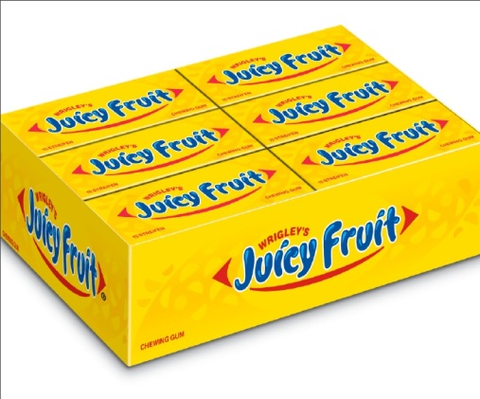
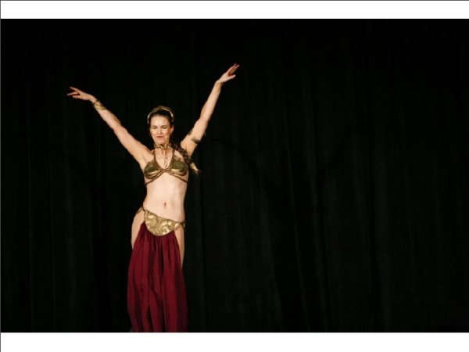
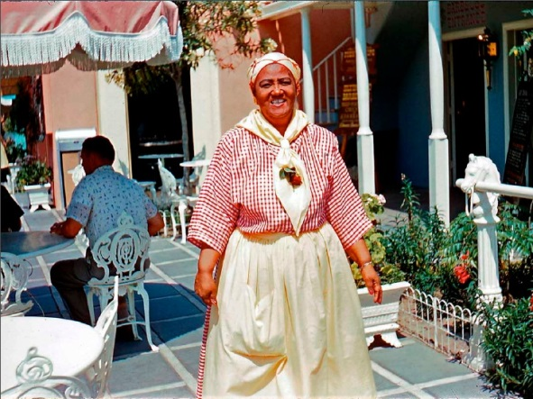

Slide 7
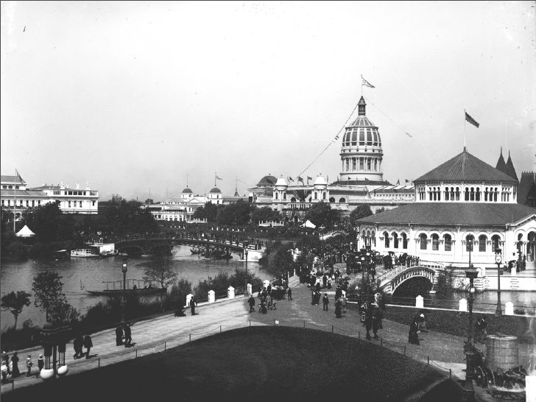

Slide 8
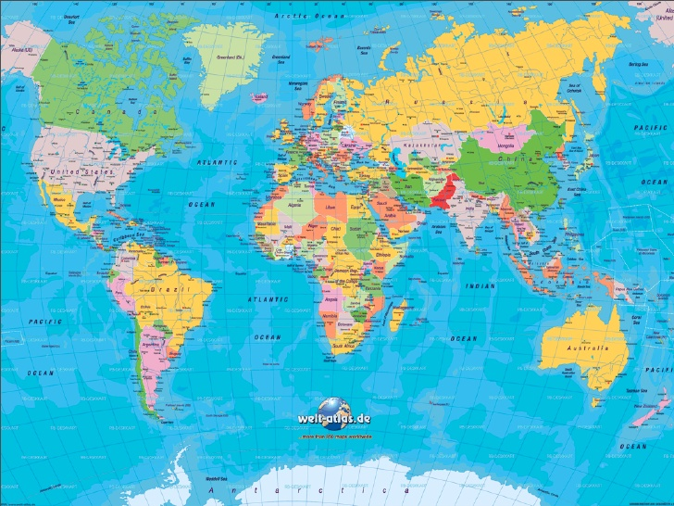

Slide 9
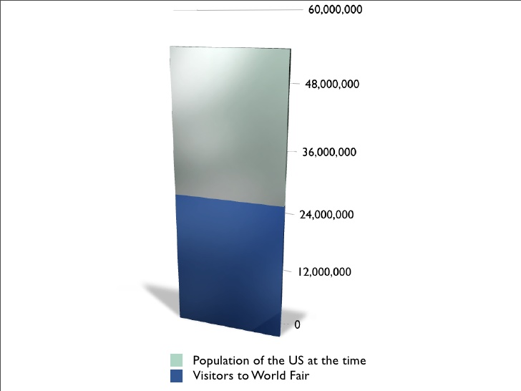

Slide 10
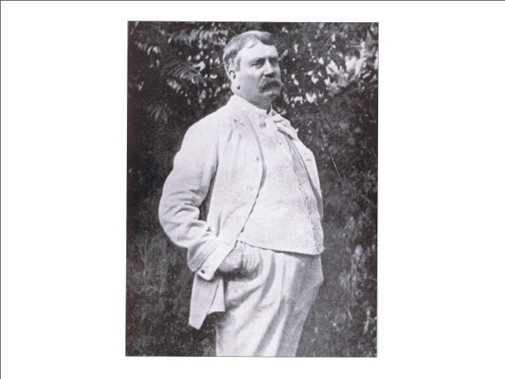
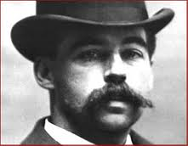
“In the end it is a story of the ineluctable conflict between good and evil, daylight and darkness, the White City and the black.”
Daniel H. Burnham
“Make no little plans; they have no magic to stir men’s blood.”
Dr. H.H. Holmes
“I was born with the devil in me. I could not help the fact that I was a murderer, no more than the poet can help the inspiration to sing.”

